Slide 1

Welcome
_{to our Presentation}

Slide 2
Ahmed Musa Al Galib
Shawon Gazi
MD. Al-Sharif
Afroza Binte Ansarul
Tamanna Ahmed Tasin
ID : 241400046
ID : 241400031
ID : 241400037
ID : 241400042
ID : 241400033

Slide 3
Topic
Automatic Water Level Indicator
using NAND Gate

Slide 4
Objective :
To monitor the water level in a tank and provide clear indication (Empty, Half, Full) using LEDs. It helps to avoid overflow, save water, and reduce electricity wastage by giving a simple and low-cost solution with basic digital electronics.

Slide 5
Why We Use Automatic Water level indicator ?
Prevent Overflow :
Without an indicator, tanks often overflow and waste a lot of water.
This circuit shows exactly when the tank is full.
Save Water :
Water is precious. By knowing the level, we avoid unnecessary wastage.
Save Electricity:
If a motor runs even when the tank is full, electricity is wasted.
This circuit helps to monitor levels and stop the motor in time.
Easy Monitoring:
LEDs clearly show whether the tank is empty, half, or full.
No need to manually check the tank again and again.

Slide 6
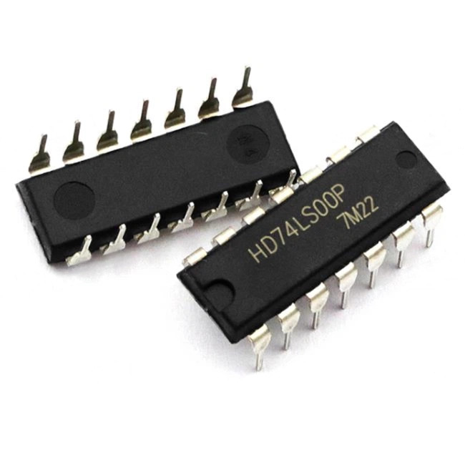
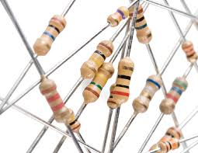
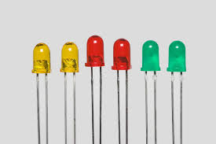
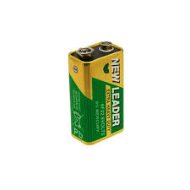
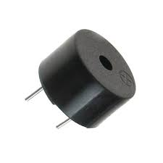
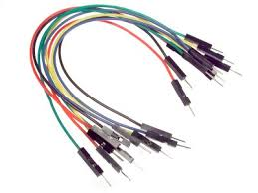

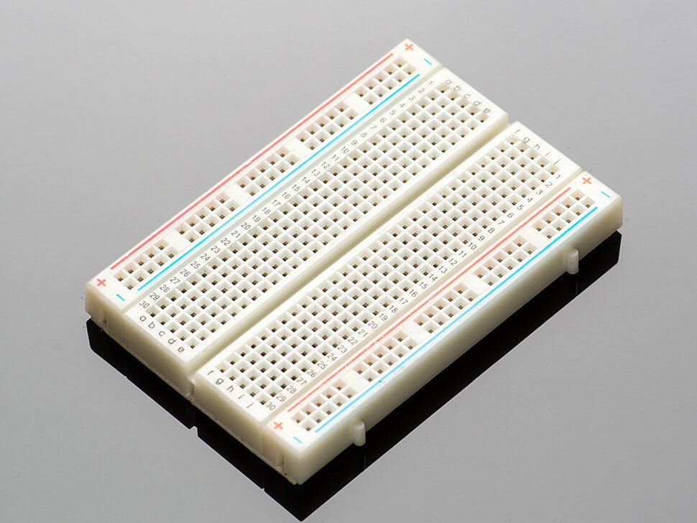
Required Components :
NAND Gate IC-7400
Resistor’s-(10k,10k,100ohm)
Led-(Red,Green,Yellow)
Battery-9v
Buzzer
Jumper wire’s
Some Wire’s
Breadboard

Slide 7


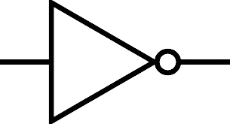

Working Principle of NAND Gate :
AND Gate
Not Gate
NAND Gate

Slide 8
Working Principle of NAND Gate :
Truth Table :
INPUT |  | OUTPUT
A | B | Y
0 | 0 | 1
0 | 1 | 1
1 | 0 | 1
1 | 1 | 0
0
1
0

Slide 9
Working Principle of NAND Gate :
Truth Table :
INPUT |  | OUTPUT
A | B | Y
0 | 0 | 1
0 | 1 | 1
1 | 0 | 1
1 | 1 | 0
0
1
1

Slide 10
Working Principle of NAND Gate :
Truth Table :
INPUT |  | OUTPUT
A | B | Y
0 | 0 | 1
0 | 1 | 1
1 | 0 | 1
1 | 1 | 0
1
1
0

Slide 11
Working Principle of NAND Gate :
Truth Table :
INPUT |  | OUTPUT
A | B | Y
0 | 0 | 1
0 | 1 | 1
1 | 0 | 1
1 | 1 | 0
1
0
1

Slide 12
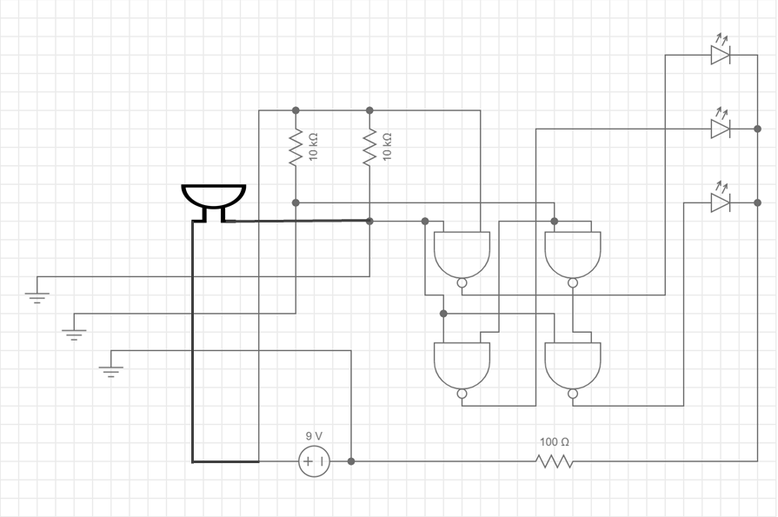
Circuit Diagram :
Green
Yellow
Water Tank
Buzzer
Red
NAND-1
NAND-4
Full
Half
Empty
NAND-2
NAND-3
9v battery

Slide 13
Circuit Diagram Discussion :
This circuit uses a NAND gate (7400)IC to monitor water levels in a tank.
Power Supply :
Pins 1 and 14 are connected to the battery’s positive terminal through two 10kΩ resistors, while pin 7 is connected to the negative terminal.
Inputs (Water Level Sensors) :
Pin 2 (linked with pins 5 and 10) and pin 4(linked with pins 12 and 13) act as sensor inputs also pin 12 and 13 pins output pin 11 connected to the pin 9. Each is connected through a 10kΩ resistor and a wire dipped into the water tank. These act as sensing probes that detect water contact.
Buzzer :
Connected between pin 14 (+) and pin 2 (–), it sounds when the tank reaches a defined level.

Slide 14
Circuit Diagram Discussion :
Outputs (LED Indicators):
Pin 3 → Green LED (indicates full/tank top reached).
Pin 6 → Yellow LED (indicates mid-level).
Pin 8 → Red LED (indicates empty/low water).
All LEDs share a 100Ω current-limiting resistor connected to ground (pin 7).
Logic Flow:
When water touches the sensor probes, the NAND gate logic changes state, activating the respective LEDs and buzzer to show whether the tank is full, mid,
or empty.

Slide 15
Circuit Diagram Implementation :
Green
Yellow
Water Tank
Buzzer
Red
NAND-1
NAND-4
Full
Half
Empty
NAND-2
NAND-3
9v battery

Slide 16
Circuit Diagram Implementation :
Green
Yellow
Water Tank
Buzzer
Red
NAND-1
NAND-4
Full
Half
Empty
NAND-2
NAND-3
9v battery

Slide 17
Circuit Diagram Implementation :
Green
Yellow
Water Tank
Buzzer
Red
NAND-1
NAND-4
Full
Half
Empty
NAND-2
NAND-3
9v battery

Slide 18
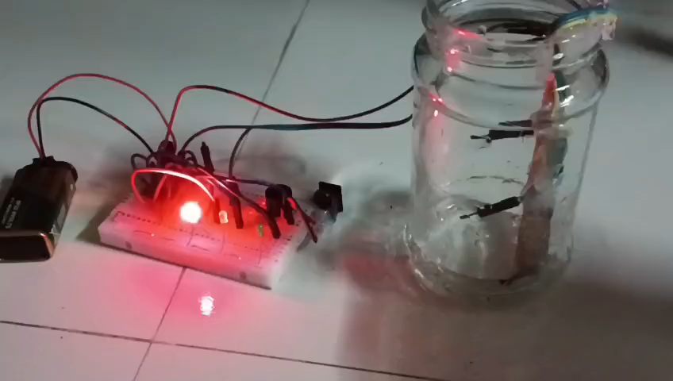
Project Video :

Slide 19
Advantage of this project
Very low cost and easy to build.
Helps in saving water and electricity.
Works automatically without human checking.
Limitations & Future Scope of this project
Limitation:
This project only shows the level. It does not automatically control the water pump.
Future Improvement:
Add a relay + motor control to automatically switch the pump ON/OFF.

Slide 20
Conclusion :
The Automatic Water Level Indicator is a simple and low-cost project that helps to monitor the water level in a tank using LEDs. By applying basic digital electronics with the NAND gate IC 7400, this circuit clearly shows when the tank is empty, half, or full. It helps to prevent overflow, save water, and reduce electricity usage, making it highly useful in homes, industries, and agriculture. This project proves how small electronic circuits can provide practical solutions to everyday problems.

Slide 21





References :
Thinker card for online simulation .
Circuit lab and every circuit for Circuit Design.
Chatgpt and Logisim for circuit Implementation.

Slide 22
Thank You

